Slide 1

Mangrove Team
Dillon Hicks, Mark Liu, Kathy Qi, Jeremy Smith

Slide 2
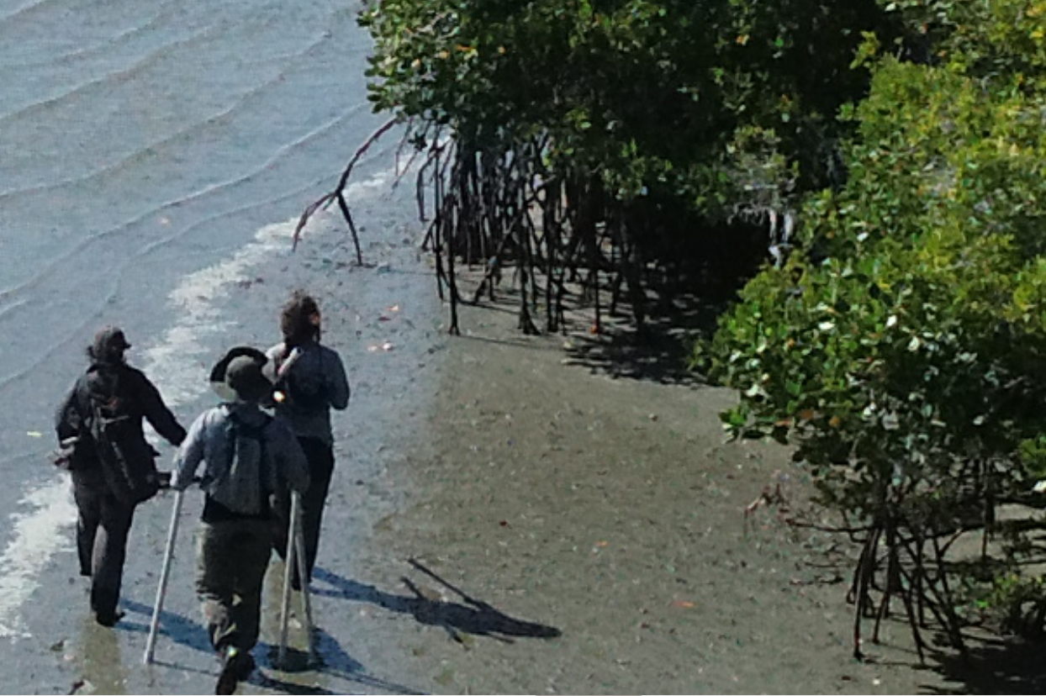
Background
Mangroves are trees and shrubs that have adapted to grow in the intertidal zone along subtropical coastlines. Over 80 species of mangroves span the globe.
Thay have significant impacts on environmental health:
Carbon sequestration
Reduction in coastal erosion
Shelter for diverse organisms
Soil enrichment

Slide 3
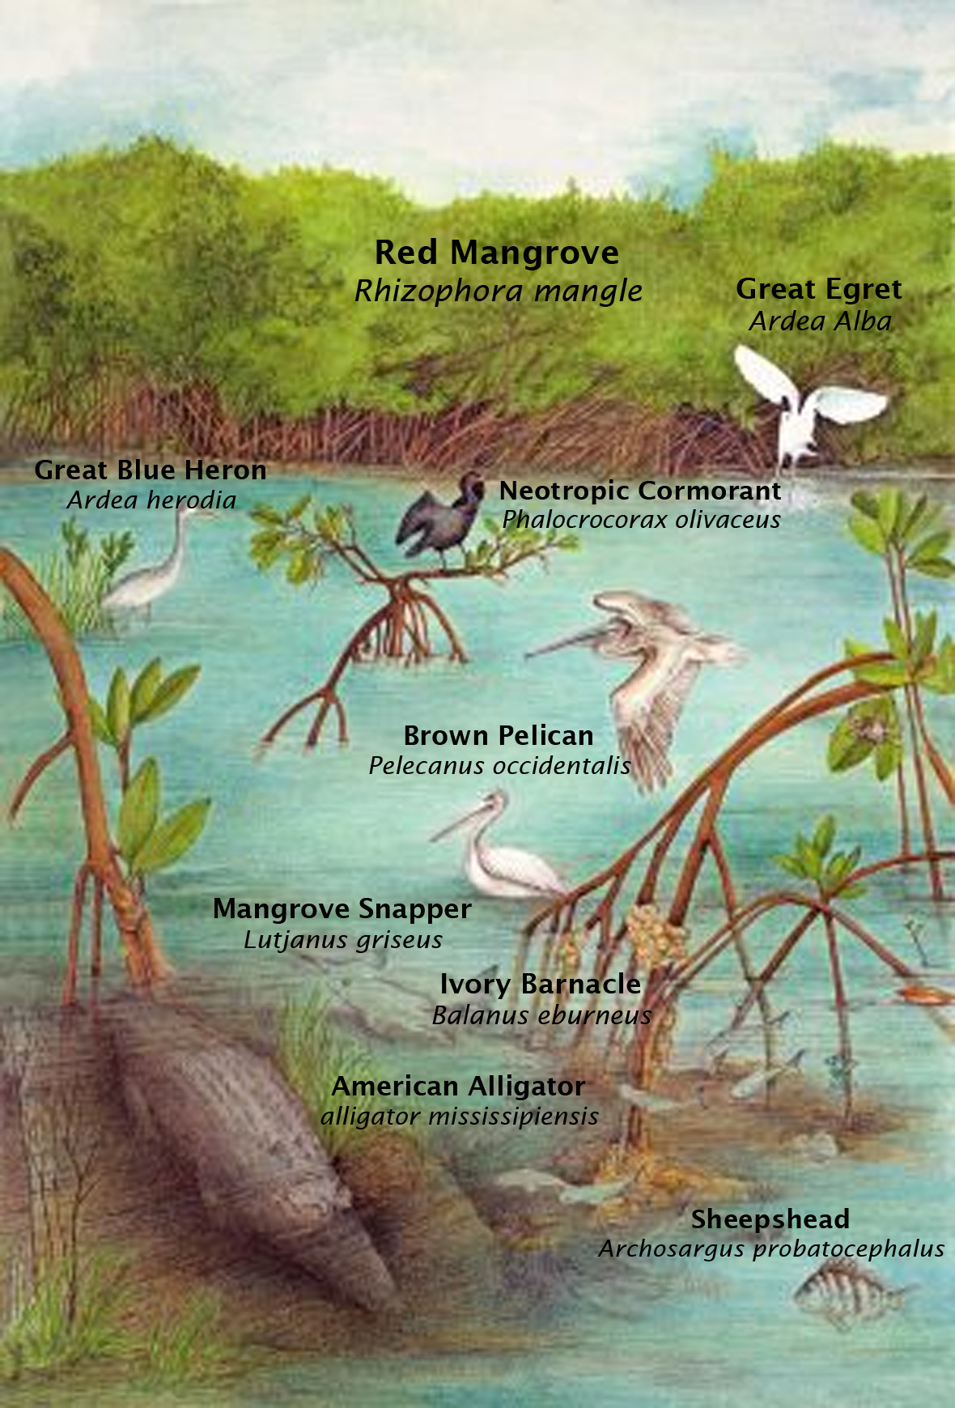
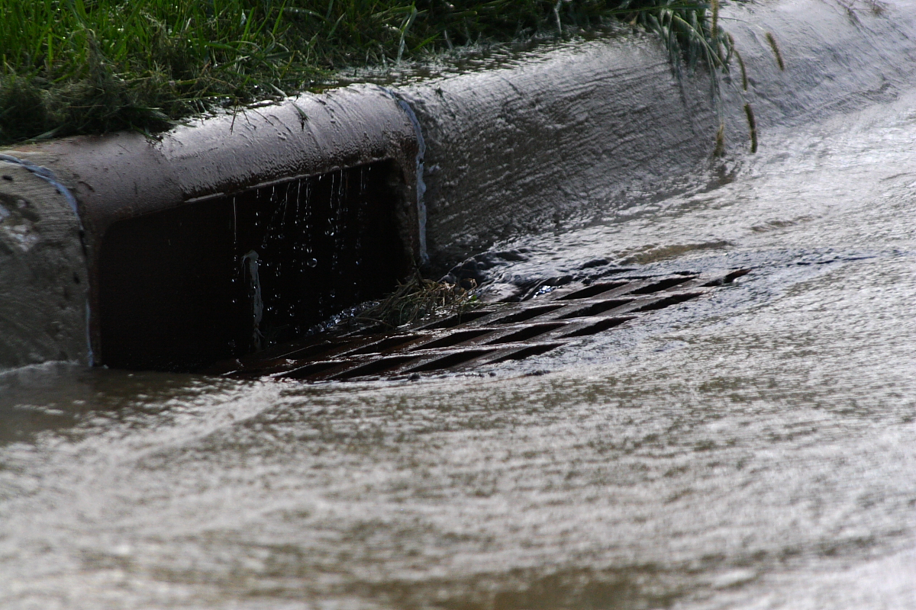
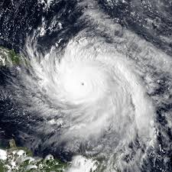
Why do we care about mangroves?
Carbon Sequestration
Wave energy dissipation
Pollutant filtration
Delicate ecosystem
Notes:
It is incredibly important to keep mangrove forests around the world healthy. Mangrove forests grow dense root systems that heavily contribute to dissipating wave energy, such as those of hurricanes or tsunamis. The roots additionally help to filter out pollutants from the water, while the mangrove itself sequesters carbon from the atmosphere. Finally, the forest helps support the ecosystem around it, providing shelter for both wild animals and fisheries.

Slide 4
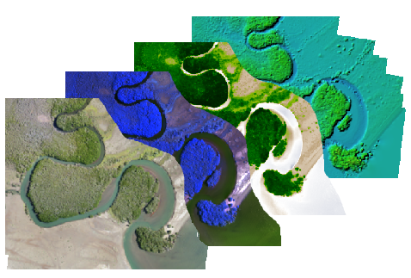
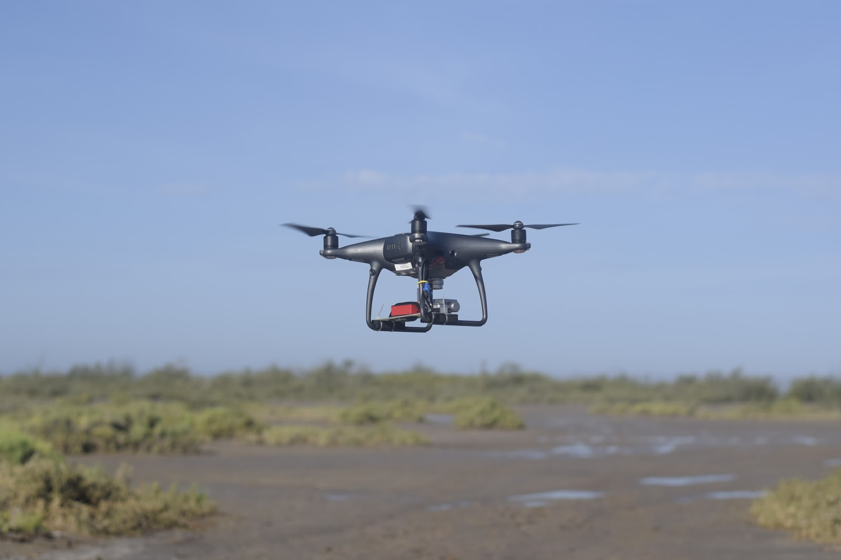
Dwarf Mangrove Species Classification
Our team is creating a scalable procedure for using drone imagery and machine learning algorithms to classify the extent and species composition of dwarf mangroves.
Notes:
Drones vs satellite resolution
Fly a drone

Slide 5
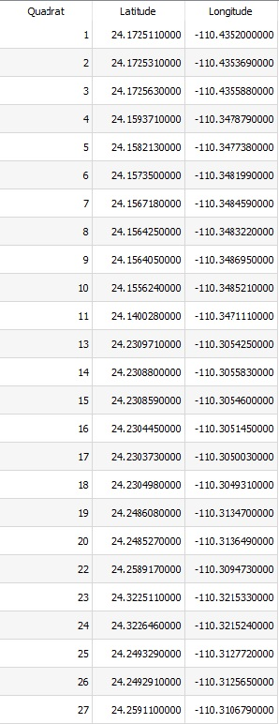
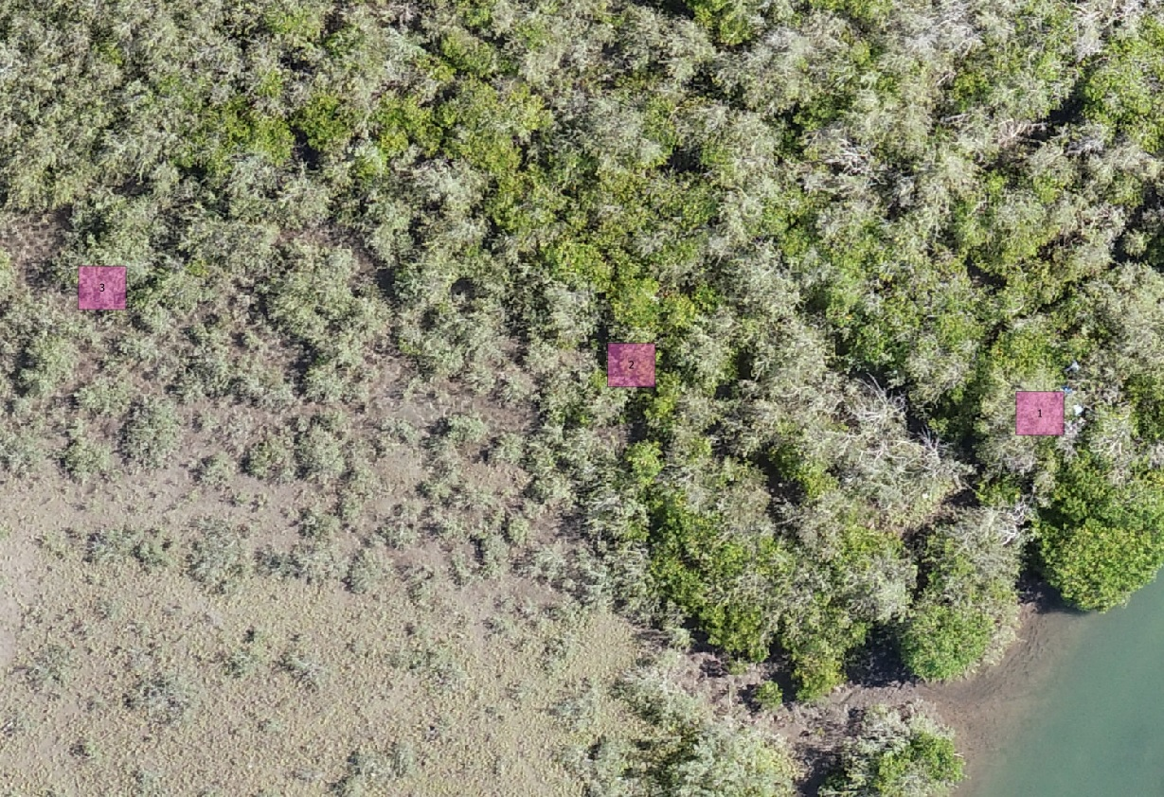
Why do we need a better GPS device?

Slide 6
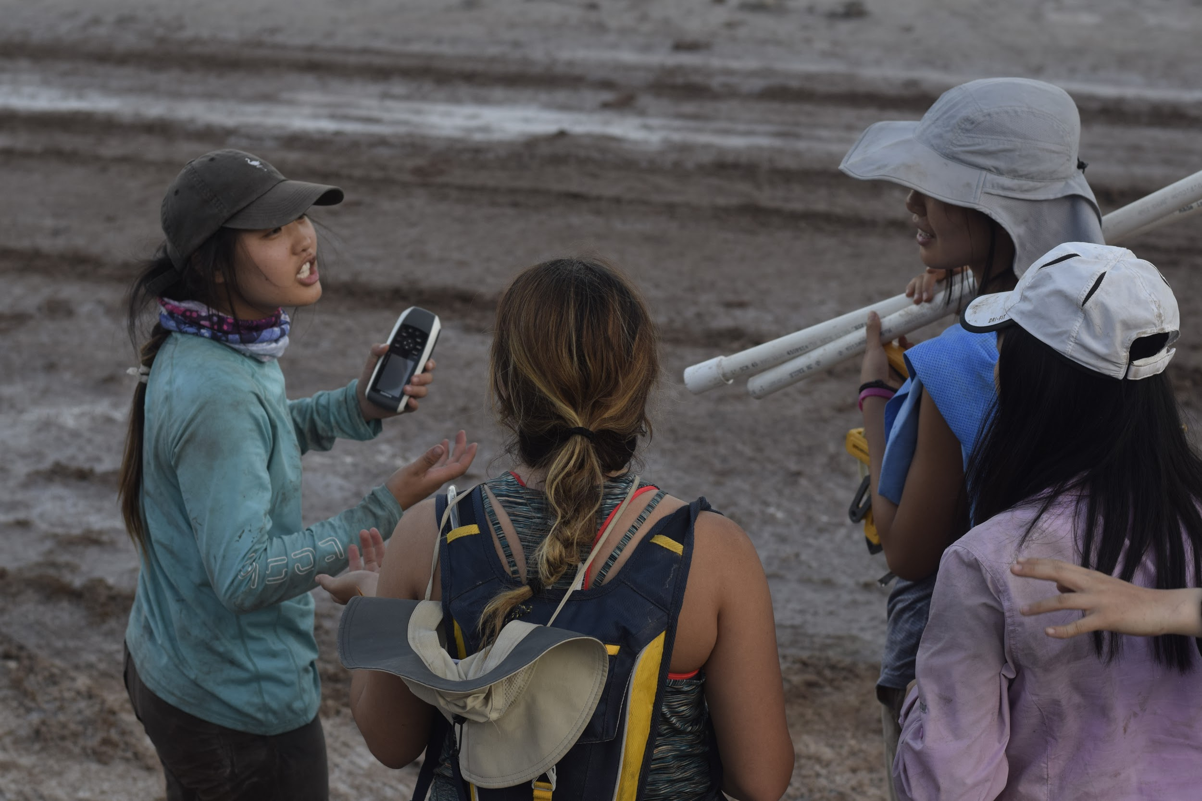
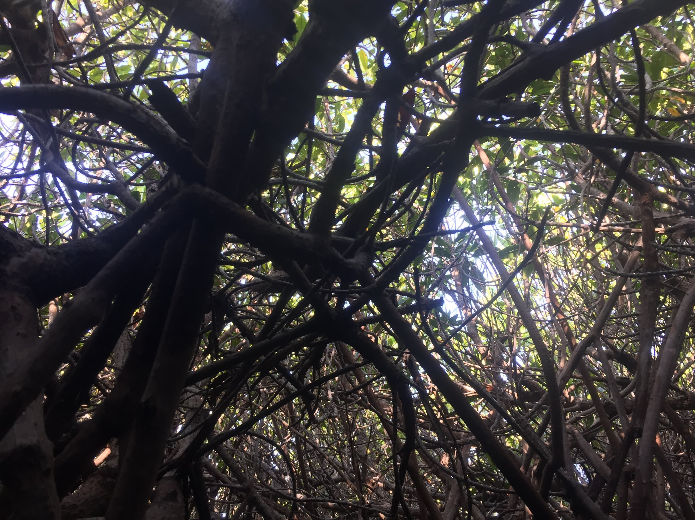
GPS- Current Tools
Pros:
Portable
Robust
Easy to track points
Cons:
High error range (10-15m)
Inaccurate results
Unreliable signal through canopy

Slide 7
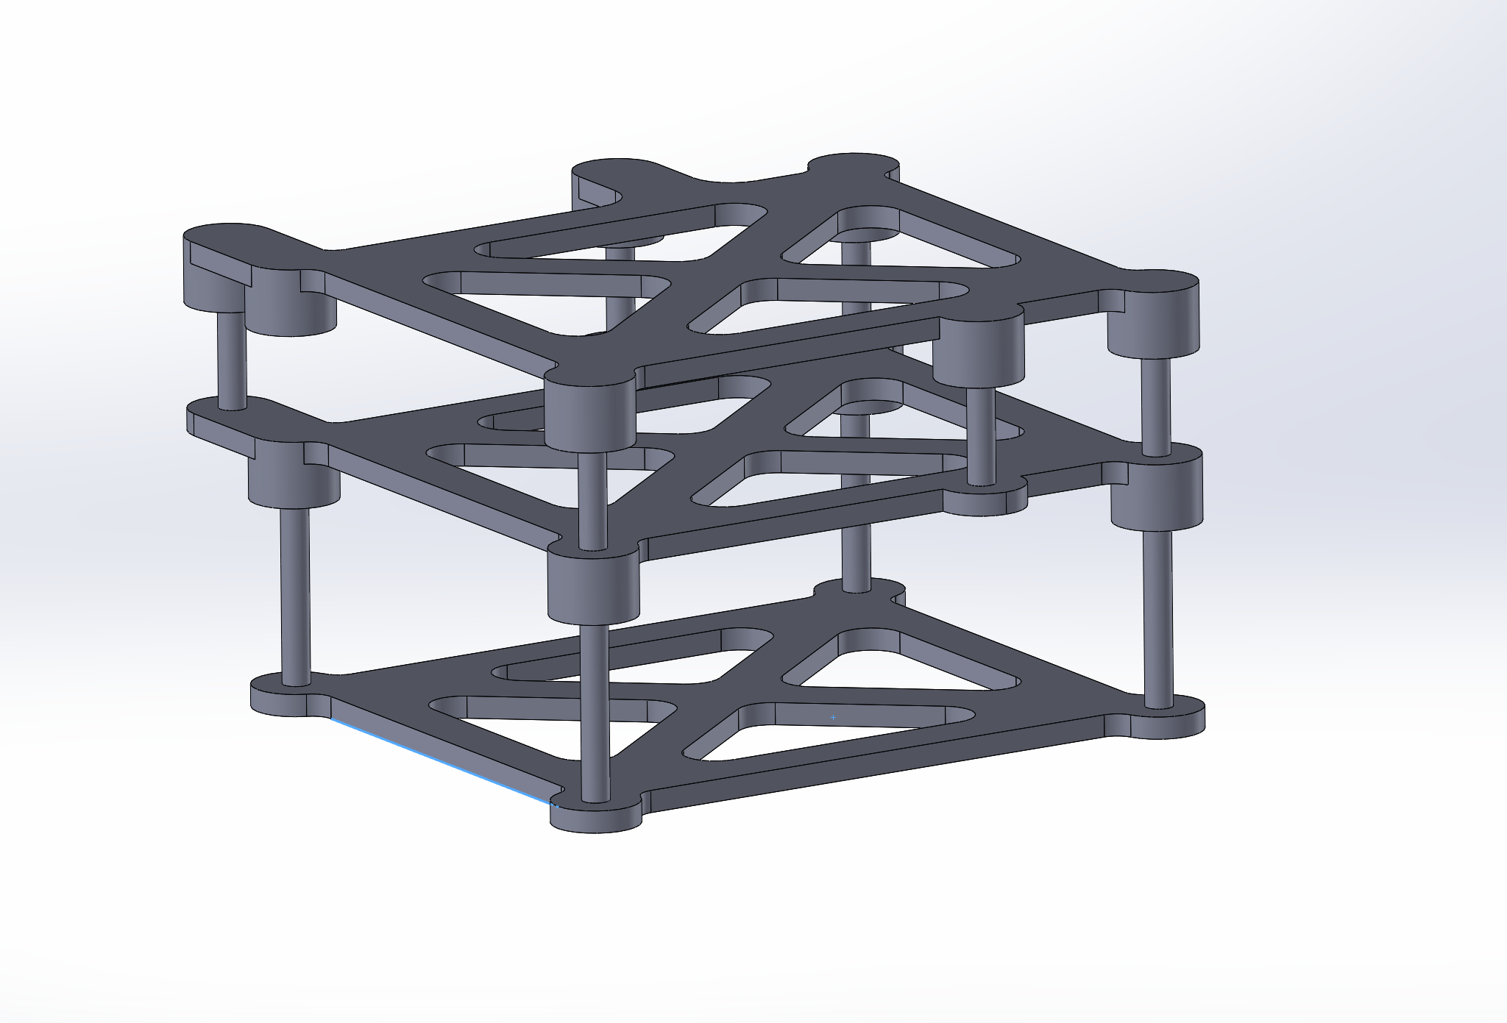
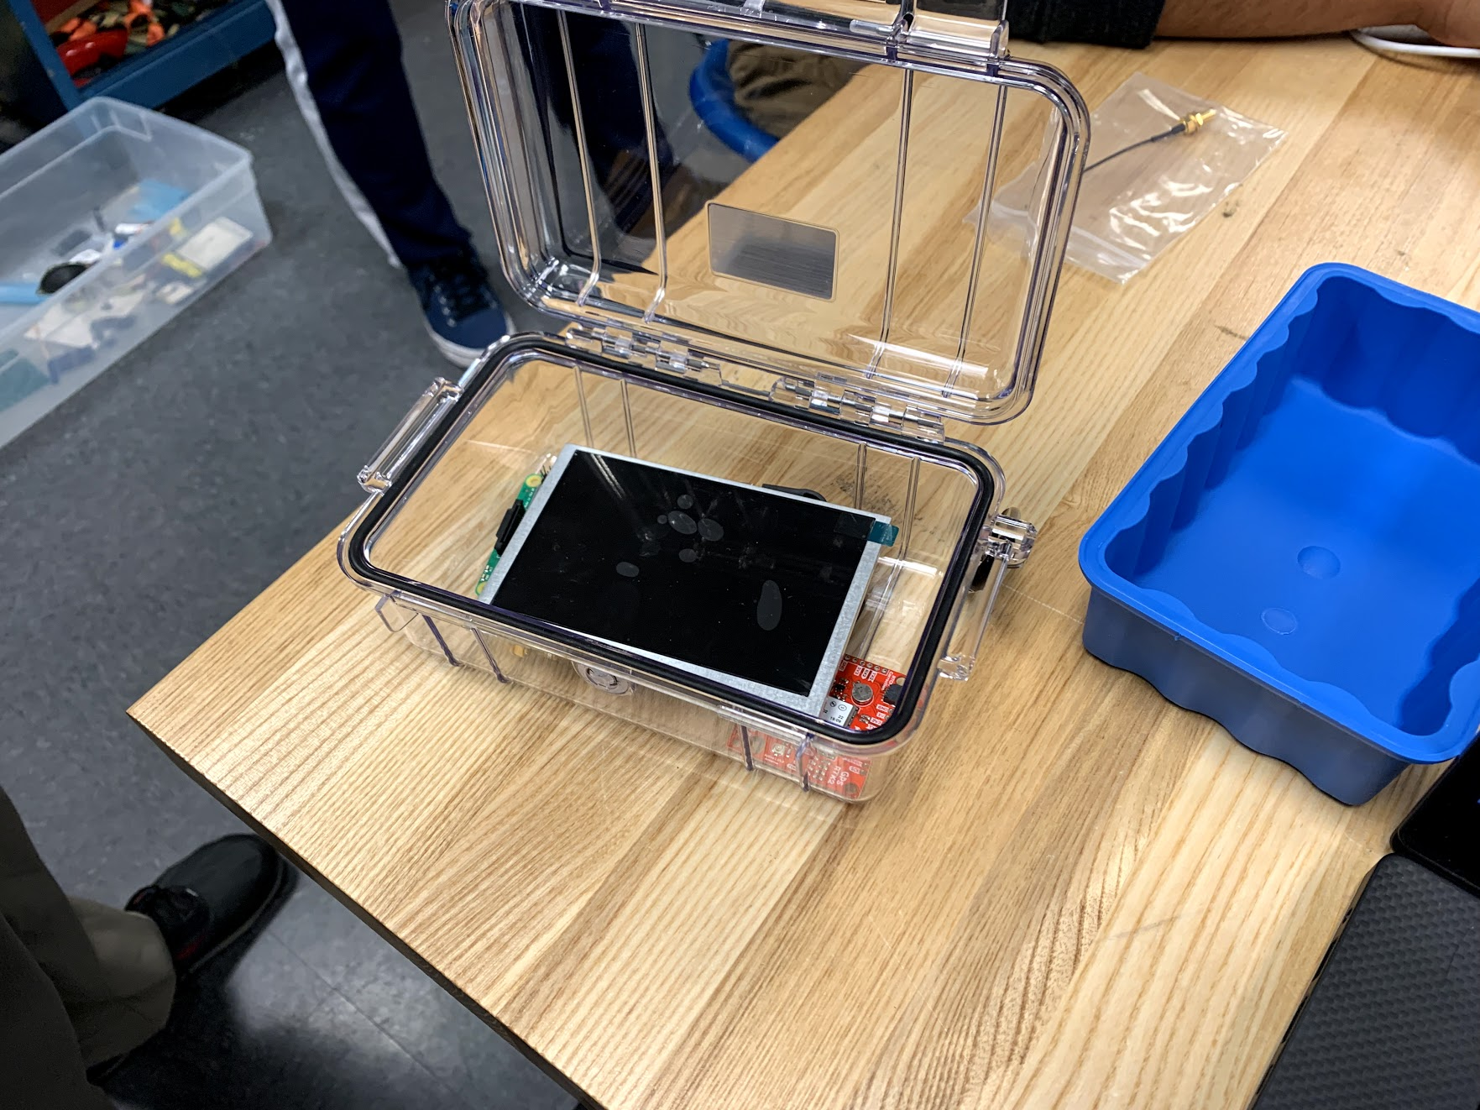
Deliverables
Device that can:
Withstand the conditions of the mangrove ecosystem
Capture GPS positions
Display maps of current imagery
Upload/Download waypoints to/from device
Have much more accurate measurements than past devices
Documentation on how to use device and how to construct the device if necessary

Slide 8
Milestones and Accomplishments
Acquisition of Parts
System Design
Mechanical
System Construction and Development
Testing and Documentation

Slide 9
Quarter Plan
Week | Task
6 | Initial Mechanical Design and First Software Iterations
7 | First Hardware Iteration and Software Improvements
8 | Final Hardware Integration with Continual Software improvements
9 | System Tests Complete
10 | Documentation Complete

Slide 10
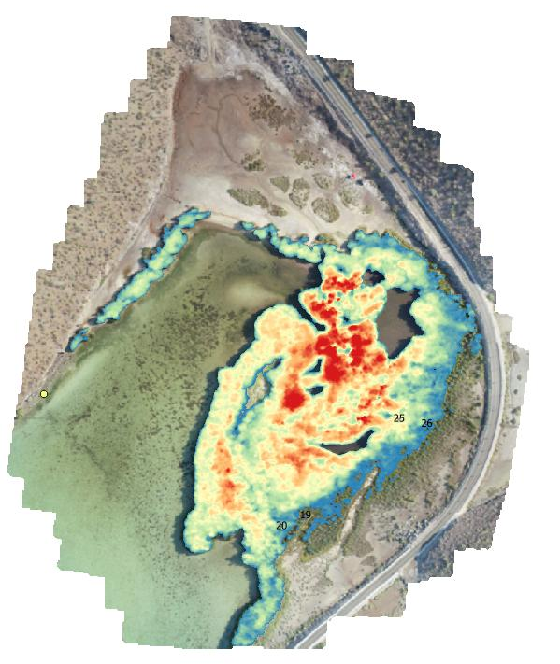
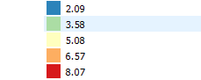
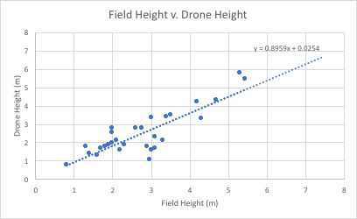
Why do we need better Canopy Height Measurements?

Slide 11
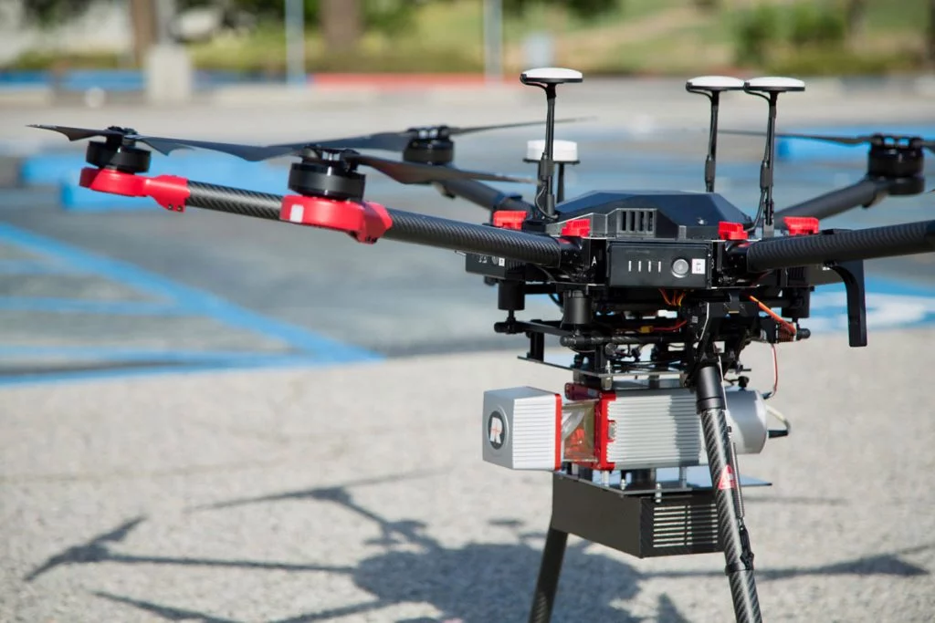
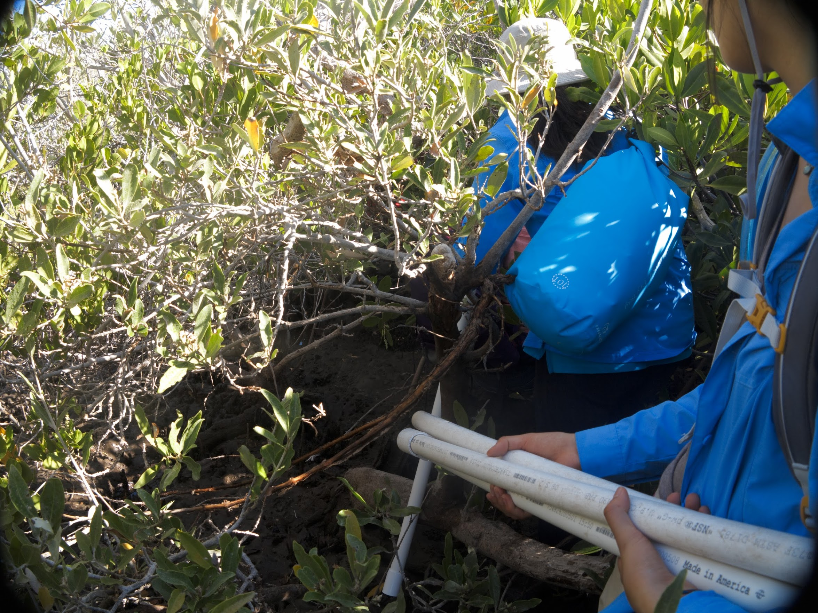
Height Estimation
Vital for biomass calculations.
Existing methods expensive and/or inaccurate.
Goal: Low-cost, low-power, accurate method of calculating mangrove height.
Notes:
Biomass calculations are important because they can give us insight into the amount of carbon stored by mangrove forests. This has direct impacts on the environmental and economic value of the forest, which is important for conservationists to be able to report to local governments.
Talk about why Lidar via drone sucks
Reliable, accurate LiDAR is expensive and may not give us reliable, precise accurate measurements.
Light may reach the bottom, but we don’t know where the actual “ground” is. For example, where would the ground be in a swampy area? To control where we want as the ground, we have to look for an alternative.
Talk about why PVC approach sucks
PVC pipe may not be stacked straight from one end to another. Thus, there may be accuracy errors. It requires a lot of physical effort to climb and stack PVC pipes. Carrying a load of PVC pipes is also a problem.
Our goal is to provide a low-cost, low-power, accurate method of calculating mangrove height.

Slide 12
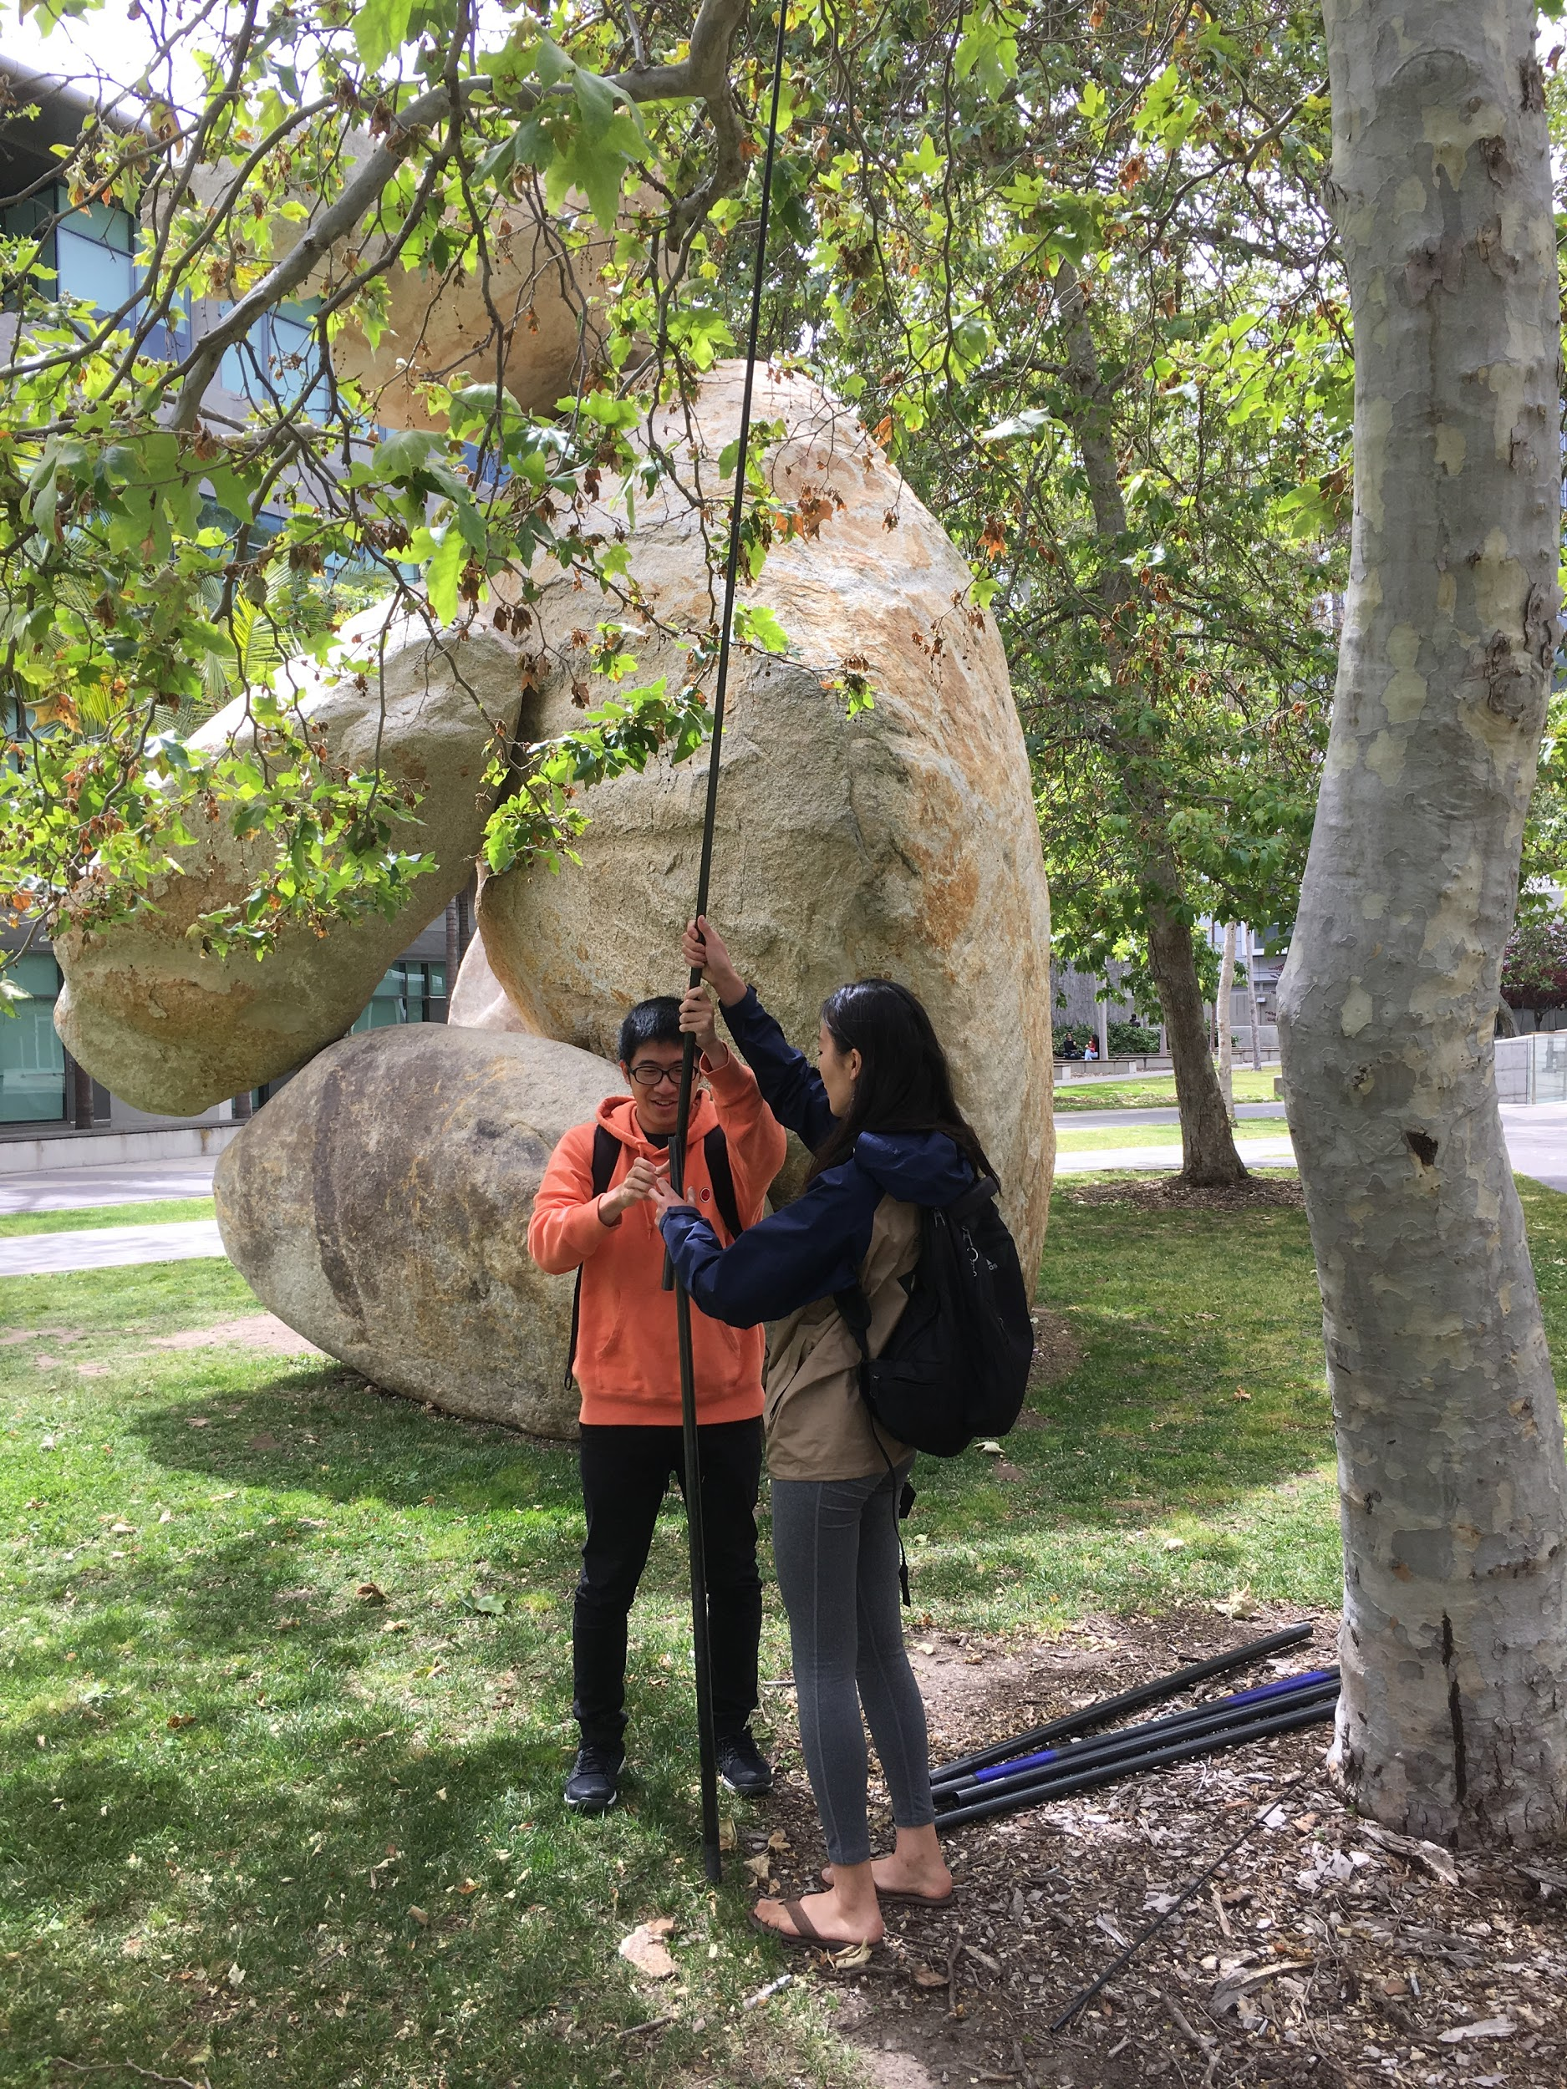
Deliverables
Sensor pod deployable by telescopic pole.
Detailed manual and instructions for reproducing the tool.
Notes:
Brief system overview.
We will also be providing a detailed set of instructions so that users may easily learn how to use the system and construct additional instances of it.

Slide 13
Milestones and Accomplishments
System Design
Acquisition of Parts
System Construction
Testing and Documentation
Notes:
So far, we have designed the overall system and ordered all of the hardware components. We have set up microcontroller as a wifi access point so that we may connect directly to it from any device equipped with a browser. We have integrated the camera with a microcontroller-hosted web page so that we may remotely monitor the video feed. Currently, we are working on integrating the altimeter onto the microcontroller and integrating it onto our web page for display alongside the video feed. We will then progress to mounting everything into a sensor pod, mounting the pod on our telescopic pole, and running field tests. We are running tests and documenting as we go.

Slide 14
Quarter Plan
Week | Task
6 | Initial tests to ensure feasibility. First software iteration.
7 | All sensors integrated with software.
8 | Refinement of software. Finalized hardware integration.
9 | System tests complete.
10 | Documentation complete.
Notes:
Each week we have a main task we want to accomplish. Talk briefly about each one.

Slide 15
Questions?

Slide 16
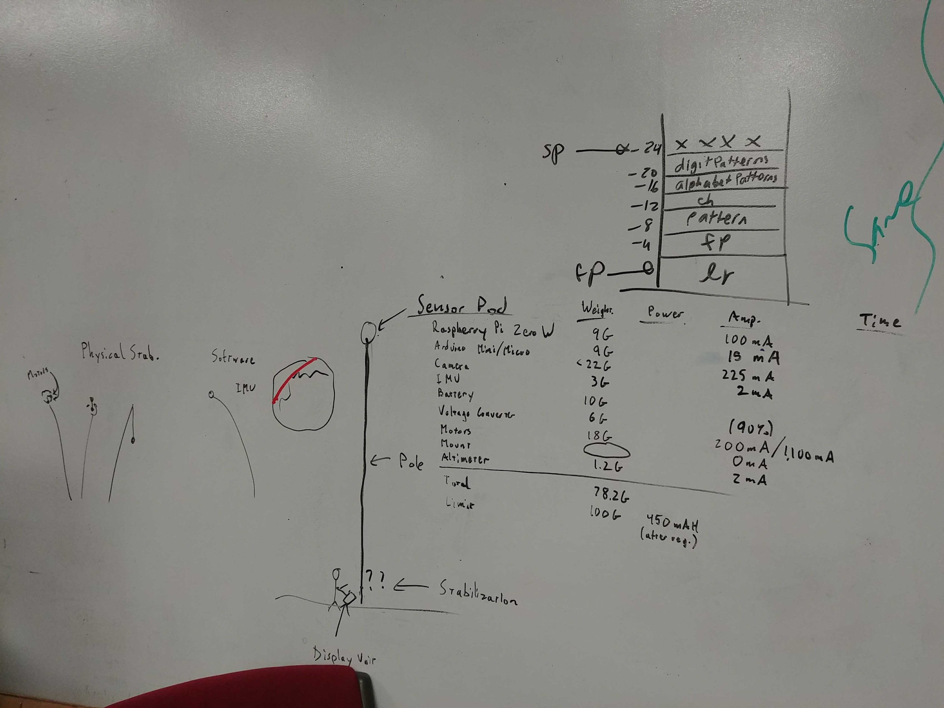
Question Handling
We have discussed possible issues that the scientists may face while collecting height data
How much power is required?
We have calculated the power usage of each parts
How heavy will it be? Will the pole be able to support that much weight?
We found the weight of each independent parts and totaled all the parts to 78.2g
We tested using the pole with an 114g object already and determined that usage is reasonable
What happens if the sensor gets damaged or stuck?
We will encase the sensors with a bottle to project it. The curvature of the bottle will reduce the probability of getting stuck.
By using a bottle, the altimeter calculation may be off. To account for this, we replace some parts of the bottle with materials that allow airflow.
Notes:
This slide is to handle any questions that we anticipate (“BUT HOW R U GONNA POWER IT?”)

